Slide 1

Fantasy Baseball Analysis– Lahman’s Database
Data 824 Fall 2021 Final Project
Joshua Barnes

Slide 2
The Problem
For years, baseball enthusiasts have come together to compete in fantasy baseball: they look at statistics for players and try to project how well the player will perform the next season, and compete head to head on various performance metrics. Although many statistics are readily available, how truly predictable is player performance? How do we know if a player is expected to do better or worse in the coming year? Much of it is speculatory, but we have hundreds of years of statistics we can use to our advantage.
In my personal research I also found it difficult to compare more than two players at a time, because visualizations were never a part of the research, just tables displaying the data.

Slide 3
The Data
Lahman’s Baseball database has been adapted for use in R. For this project, we will only be interested in the ‘People’ table joined to the ‘Batting’ table(22 variables and 108789 rows) These tables have been maintained to contain season-over-season statistics since 1871, and are open-sourced under Creative Commons Share-Alike3.0 (free to use, share, and adapt if credit is given, and any modifications must be published under the same licensure).
Fantasy Baseball only cares about these stats: hits, home runs, batting average, stolen bases, and runs batted in (RBI); but many people waste their high picks with individuals who are injury-prone, high-power players. To avoid these and other biases, I have removed player seasons that had less than 100 games played, and normalized the statistics to be on a per-game basis.

Slide 4
The Solution
Players have a trajectory based on their age and experience level in the majors. As such, I first aggregated the dataset and grouped the players by the season number in the league. If a player had their rookie year in 2001, their rookie year would be aggregated with other players’ rookie years, regardless of what year that season was. Doing this should remove bias and show growth –and decline – based on player age and experience level. To maintain a similar era, I made sure to only keep seasons that were after 1990.
The solution is to create an app that compares season-over-season statistics for different individuals, such as batting average, to know if the players are a good draft or not not.

Slide 5
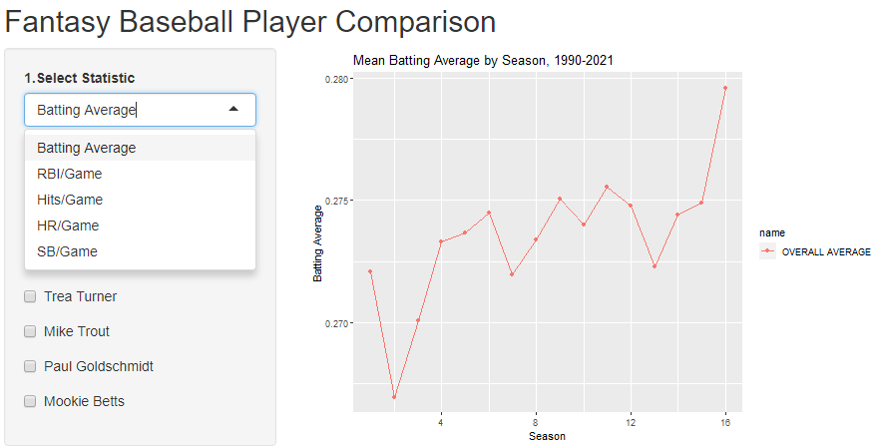
The App
1. Select a statistic.
2. Select a few players.
3. Compare the players.
4. Win your fantasy league.

Slide 6
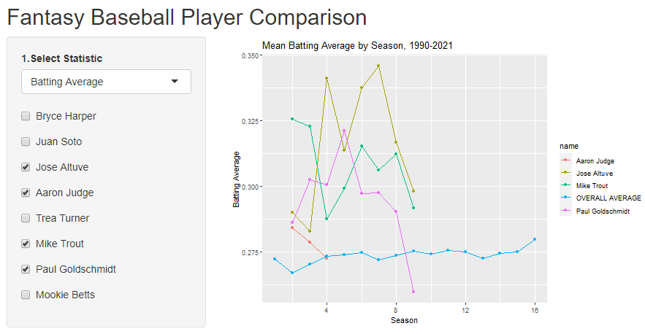
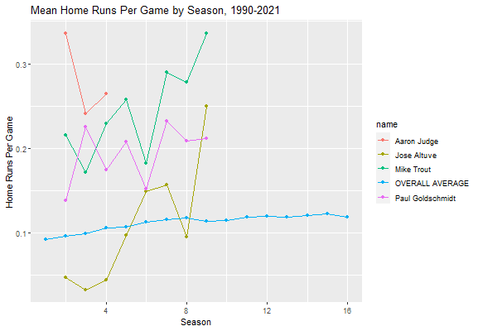
Results
Using this method, one of the ‘best’ fantasy players was completely excluded because of his injuries: DO NOT DRAFT FERNANDO TATIS, he’s a high risk and there are much better players to choose from.

Slide 7
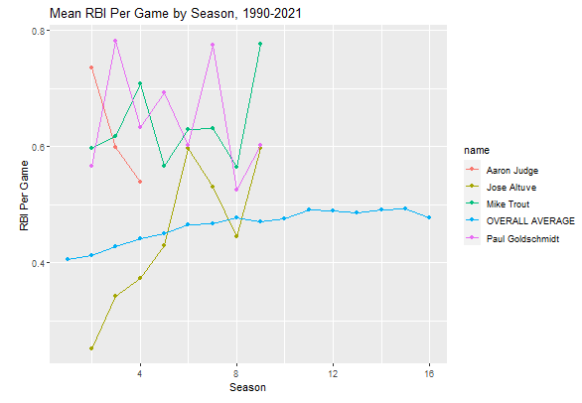
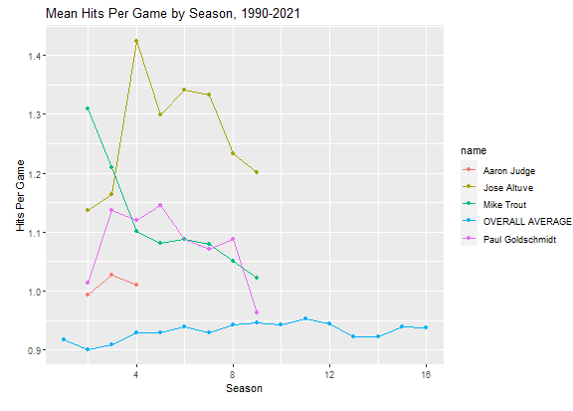
Results
RBI per game, on average, increase per season,
as do hits per game, but batting averages and
home runs per game largely remain constant.
If there is a young player that, early in his career, hits a
lot of home runs and is not injury-prone, they’d be a
good player to look at drafting.

Slide 8
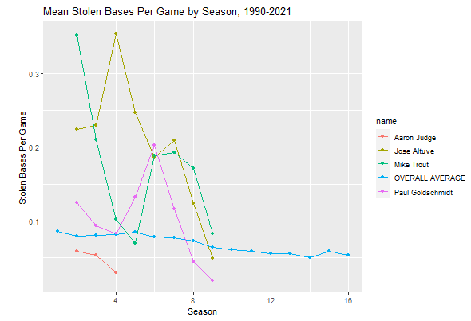
Results
Stolen bases is one thing
that clearly changes over
time; as players get older,
they steal less frequently.
If you want steals, you need a
younger player.

Slide 9
Further Research/Development
It would be interesting to be able to search for a specific player to add to the visualizations as opposed to some arbitrarily selected power players in the league.
It would also be nice to be able to rank those compared to determine head-to-head who would be the best draft pick
This could easily be adapted to a second app for pitchers and defensive statistics, the other half of fantasy baseball.
Any other suggestions/improvements are welcome!
https://github.com/sabermetrist/Shiny

Slide 10
Thank you!

